Slide 1
Responsive design

Slide 2
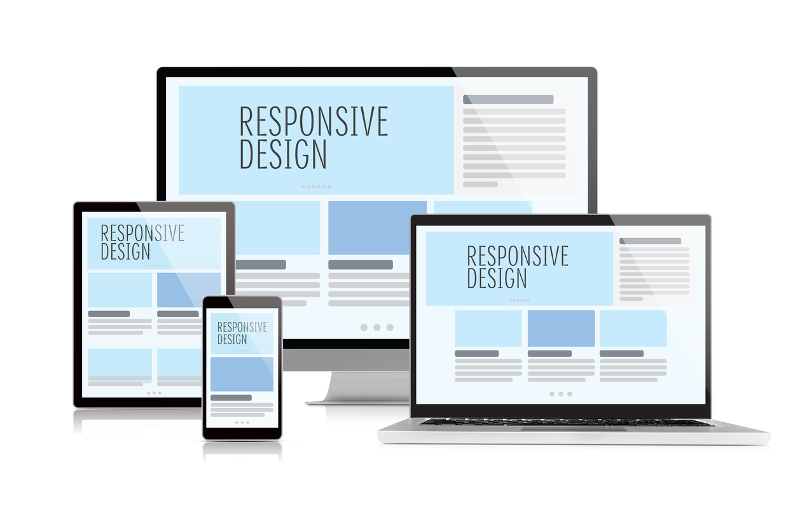
What is responsive design?
Responsive design is a technique used while creating websites so the web page and interactions respond to the user’s screen size, platform and orientation.
Notes:
https://www.webfx.com/blog/web-design/understanding-the-elements-of-responsive-web-design/

Slide 3
What is a media query?
Media query is a CSS technique introduced in CSS3. It uses the @media rule to include a block of CSS properties only if a certain condition is true.
Example:
If the browser window is 600px or smaller, the background color will be light blue:
@media only screen and (max-width: 600px) { body { background-color: lightblue; } }

Slide 4
Media queries can be used to check many things, such as:
width and height of the viewport
width and height of the device
orientation (is the tablet/phone in landscape or portrait mode?)
resolution
Take a look: https://www.w3schools.com/cssref/tryit.asp?filename=trycss3_media3

Slide 5
Normal breakpoints
/* Extra small devices (phones, 600px and down) */ @media only screen and (max-width: 600px) {...} /* Small devices (portrait tablets and large phones, 600px and up) */ @media only screen and (min-width: 600px) {...} /* Medium devices (landscape tablets, 768px and up) */ @media only screen and (min-width: 768px) {...} /* Large devices (laptops/desktops, 992px and up) */ @media only screen and (min-width: 992px) {...} /* Extra large devices (large laptops and desktops, 1200px and up) */ @media only screen and (min-width: 1200px) {...}

Slide 6
What is Bootstrap?
Bootstrap is a web framework created by Twitter. It is free, open source and the most popular HTML, CSS and JS framework for developing responsive, mobile first projects on the web. Bootstrap consists of a code base (CSS and JavaScript libraries) that makes web development quicker and more streamlined. Bootstrap’s easy-to-use grid system takes a lot of the work out of implementing responsive design techniques.
Bootstrap’s grid allows for designers to easily create responsive layouts.
Bootstrap’s CSS library is used to style tyle, forms, tables, buttons, lists, images and navigation bars.
Bootstrap’s JavaScript library is helpful for creating modals, carousels, alerts, popups, dropdowns, accordions and more.

Slide 7
What is a framework?
A framework is a set of code (HTML, CSS, JavaScript) that is meant to automate web development activities. Developers can reuse and modify code from the framework as opposed to creating everything themselves from scratch.
Prevent repetition between projects
Utilize responsive design to allow your website to adapt to various screen sizes – mobile, desktop, and everything in between
Add consistency to design and code between projects and between developers
Quickly and easily prototype new designs
Ensure cross-browser compatibility

Slide 8
Getting started
The Bootstrap site contains most of the info you need to work with the framework. Look carefully at the documentation, examples and themes.
The grid system is one of the most useful features of Bootstrap. We will learn more about it below.
Look closely at the components section of the documentation. This contains reusable code snippets for items like navigation bars, icons, forms and much more.

Slide 9
Setting up a Bootstrap template
There are two way to call Bootstrap into your document:
You can download and host all of the source files in your project folder.
Or you can call the needed files from a CDN (content delivery network). This is the method we will use in class.

Slide 10
To set up this template, follow a few steps (1/2)
Start with HTML boilerplate and standard HTML tags (doctype, html, head, title and body tags. Few standard meta tags for Google)
Add the Bootstrap CSS file in the header
<!-- Bootstrap CSS --> <link rel="stylesheet" href="https://stackpath.bootstrapcdn.com/bootstrap/4.3.1/css/bootstrap.min.css" integrity="sha384-ggOyR0iXCbMQv3Xipma34MD+dH/1fQ784/j6cY/iJTQUOhcWr7x9JvoRxT2MZw1T" crossorigin="anonymous">

Slide 11
To set up this template, follow a few steps (2/2)
3. Add the required JavaScript files (Bootstrap, jQuery and Popper) at the bottom of the document, right above the </body> tag
<!-- jQuery first, then Popper.js, then Bootstrap JS --> <script src="https://code.jquery.com/jquery-3.3.1.slim.min.js" integrity="sha384-q8i/X+965DzO0rT7abK41JStQIAqVgRVzpbzo5smXKp4YfRvH+8abtTE1Pi6jizo" crossorigin="anonymous"></script> <script src="https://cdnjs.cloudflare.com/ajax/libs/popper.js/1.14.7/umd/popper.min.js" integrity="sha384-UO2eT0CpHqdSJQ6hJty5KVphtPhzWj9WO1clHTMGa3JDZwrnQq4sF86dIHNDz0W1" crossorigin="anonymous"></script> <script src="https://stackpath.bootstrapcdn.com/bootstrap/4.3.1/js/bootstrap.min.js" integrity="sha384-JjSmVgyd0p3pXB1rRibZUAYoIIy6OrQ6VrjIEaFf/nJGzIxFDsf4x0xIM+B07jRM" crossorigin="anonymous"></script>

Slide 12
Containers
Containers are the most basic layout element in Bootstrap and are required when using Bootstrap. Containers can be nested, though you probably won’t need to do that.
Choose from a responsive, fixed-width container (meaning its max-width changes at each breakpoint) or fluid-width (meaning it’s 100% wide all the time).
<!-- Open container --> <div class=”container”> </div> <!-- Full width container --> <div class=”container-fluid”> </div>
Notes:
https://getbootstrap.com/docs/4.1/layout/grid/

Slide 13
Rows
Next come rows. Rows are wrappers for columns. In a grid layout, content must be placed within columns and only columns may be immediate children of rows.
<!-- Open container --> <div class=”container”> <!-- Open row --> <div class=”row”> </div> <!-- There can be multiple rows in a single container --> <div class=”row”> </div> </div>
Notes:
https://getbootstrap.com/docs/4.1/layout/grid/

Slide 14
Columns
Inside rows are columns. Rows must contain 12 columns. Column classes indicate the number of columns you’d like to use out of the possible 12 per row. So, if you want three equal-width columns across, you can use .col-4.
<!-- Open container --> <div class=”container”> <!-- Open row --> <div class=”row”> <!-- Three, equal-width columns --> <div class=”col-4”></div> <div class=”col-4”></div> <div class=”col-4”></div> </div> </div>
Notes:
https://getbootstrap.com/docs/4.1/layout/grid/

Slide 15
How it works
Column widths are set in percentages, so they’re always fluid and sized relative to their parent element.
Columns have horizontal padding to create the gutters between individual columns, however, you can remove the margin from rows and padding from columns with .no-gutters on the .row.
To make the grid responsive, there are five grid breakpoints, one for each responsive breakpoint: all breakpoints (extra small), small, medium, large, and extra large.
Grid breakpoints are based on minimum width media queries, meaning they apply to that one breakpoint and all those above it (e.g., .col-sm-4 applies to small, medium, large, and extra large devices, but not the first xs breakpoint).
Notes:
https://getbootstrap.com/docs/4.1/layout/grid/

Slide 16
How it works
 | Extra small <576px | Small ≥576px | Medium ≥768px | Large ≥992px | Extra large ≥1200px
Max container width | None (auto) | 540px | 720px | 960px | 1140px
Class prefix | .col- | .col-sm- | .col-md- | .col-lg- | .col-xl-
# of columns | 12
Gutter width | 30px (15px on each side of a column)
Nestable | Yes
Column ordering | Yes
Notes:
https://getbootstrap.com/docs/4.1/layout/grid/

Slide 17
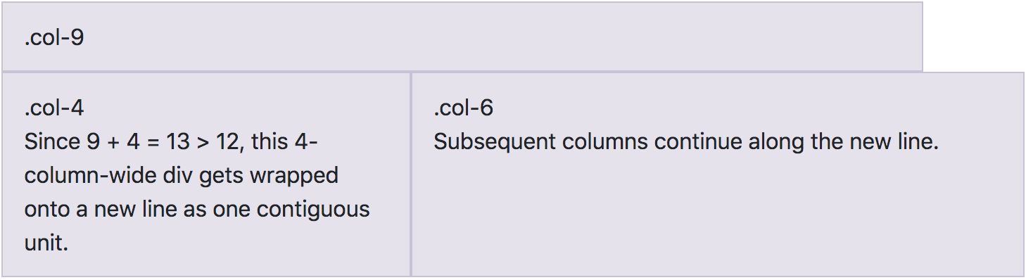
Column wrapping
If more than 12 columns are placed within a single row, each group of extra columns will, as one unit, wrap onto a new line.
Notes:
https://getbootstrap.com/docs/4.1/layout/grid/

Slide 18
Responsive grids
Assign multiple classes to column divs to change the behavior on different screen sizes.
<!-- Open container --> <div class=”container”> <!-- Open row --> <div class=”row”> <!-- Three, equal-width columns on screens at or above 768px, stacked, 100% width columns on screens below --> <div class=”col-sm-12 col-md-4”></div> <div class=”col-sm-12 col-md-4”></div> <div class=”col-sm-12 col-md-4”></div> </div> </div>
Notes:
https://getbootstrap.com/docs/4.1/layout/grid/

Slide 19
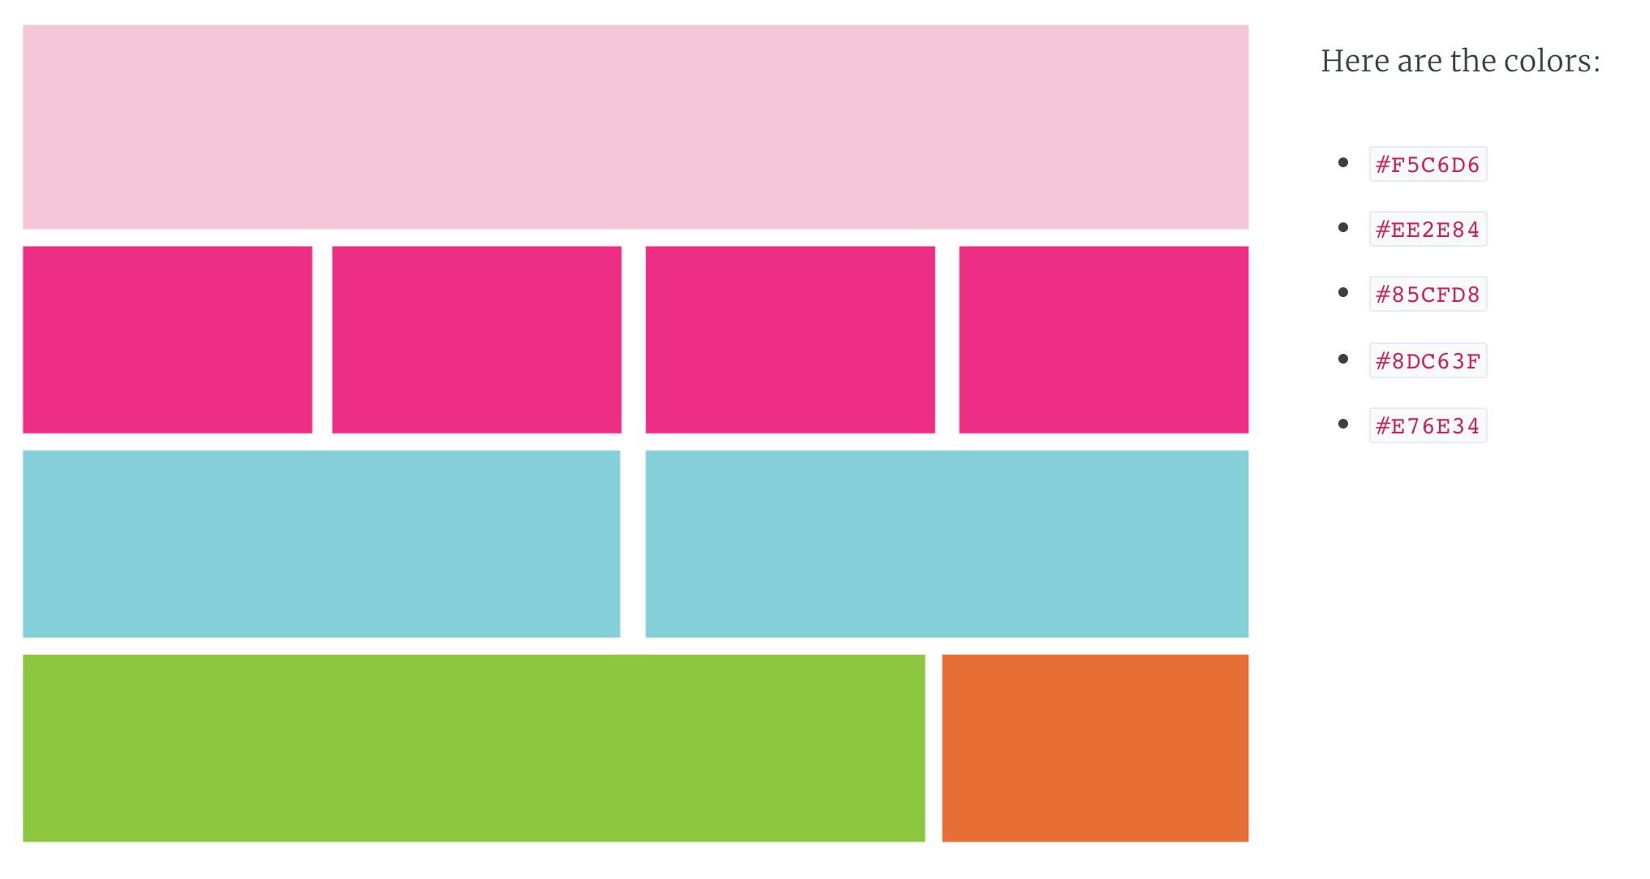
Let’s try it

